Slide 1



Fitness Tracking
Featuring Fitbit
Group F

Slide 2
Presentation Structure
Problem description - Problem explanation and contextualization.What type of analysis you want to perform?
Data Sources - What are the sources of data? What are the original data formats of every dataset?
Data Ingestion - How are you ingesting the data for each of the sources? Include your NiFi workflows
Data Storage - How are you storing the data? HDFS directory structure of your datasets
Data Processing - How are you processing the data? How are you querying the data? Spark notebooks (data engineering & data analytics)
Project Results - Did you get any insights?
Conclusions
References

Slide 3


Outline
Introduction
Overview
Data Ingestion
Data Processing
Conclusions

Slide 4

Introduction
Problem description
Problem explanation and contextualization.What type of analysis you want to perform?

Slide 5


GREG
Dataset overview
Origin
This dataset was selected from Kaggle
Access - LINK
Content
The dataset contains FitBit data submitted by 30 users on the Fitabase platform
Files
The dataset contains 18 csv files ranging from 18 KiB to 90 MiB
Notes:
Thank you Jorge. Let me know take you through a brief description of the dataset used in our project.
We picked this dataset from Kaggle. It contains data submitted by 30 FitBit users through Fitabase. Fitabase is a platform on which you can export data from connected devices, such as Fitbit, garmin, dexCom and other activity tracking devices.
A total of 18 csv files compose the dataset
Each file is related to a different variable tracked by FitBit. For example ‘Calories spent’ or ‘Heart rate per second’

Slide 6
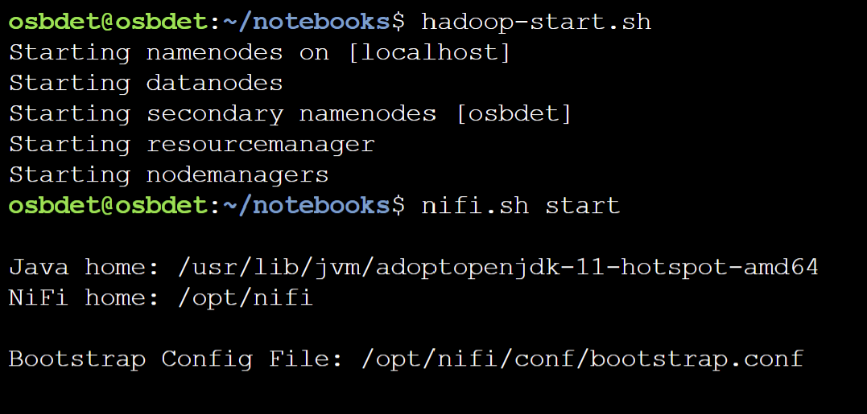
GREG
Data Ingestion
Starting NiFi and Hadoop
Notes:
For this project we are ingesting data using Nifi, which is one of the technologies in the big data ecosystem used to ingest batch data.
Let’s now start with the ingestion process:
We begin by initiating hadoop and nifi

Slide 7
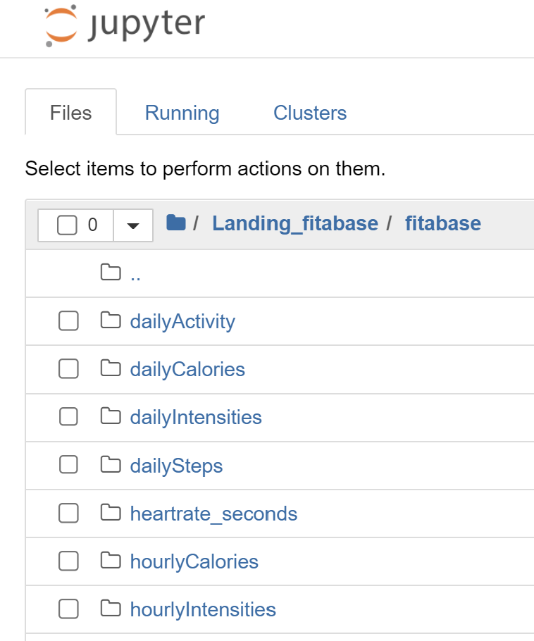



GREG
Data Ingestion
Data Sources
Title 01
Title 04
You can customize anything you see in.
You can customize anything you see in.
1
2
3
4
Sources
Ingestion
Storage
Processing
Theme - files icon
Notes:
Secondly we create a landing area for our files in jupyter notebook. - We put each file into a separate folder, ready to be ingested by Nifi

Slide 8
GREG
Data Ingestion
Data Ingestion - Nifi
ListFile
01
Retrieves the files from our local file system. For each file, creates a FlowFile that represents the file so that it can be fetched in conjunction with FetchFile
FetchFile
02
Reads the contents of a file from disk and streams it into the contents of an incoming FlowFile
UpdateAttribute
03
Updates the Attributes for a FlowFile by using the Attribute Expression Language
PutHDFS
1
2
3
4
04
Transfers FlowFile data to Hadoop Distributed File System (HDFS)
Sources
Ingestion
Storage
Processing
Theme - files icon
Notes:
The third step consists of creating our Nifi flow. For this project we use 4 processors:
ListFile, which creates a FlowFile for each one of our files so that it can be fetched in conjunction with Fetchfile
FetchFile, which reads the content of our files and streams it into the contents of the related flowfile
UpdateAttribute,
Finally PutHDFS, which transfers the flowfile data to HDFS for storage

Slide 9
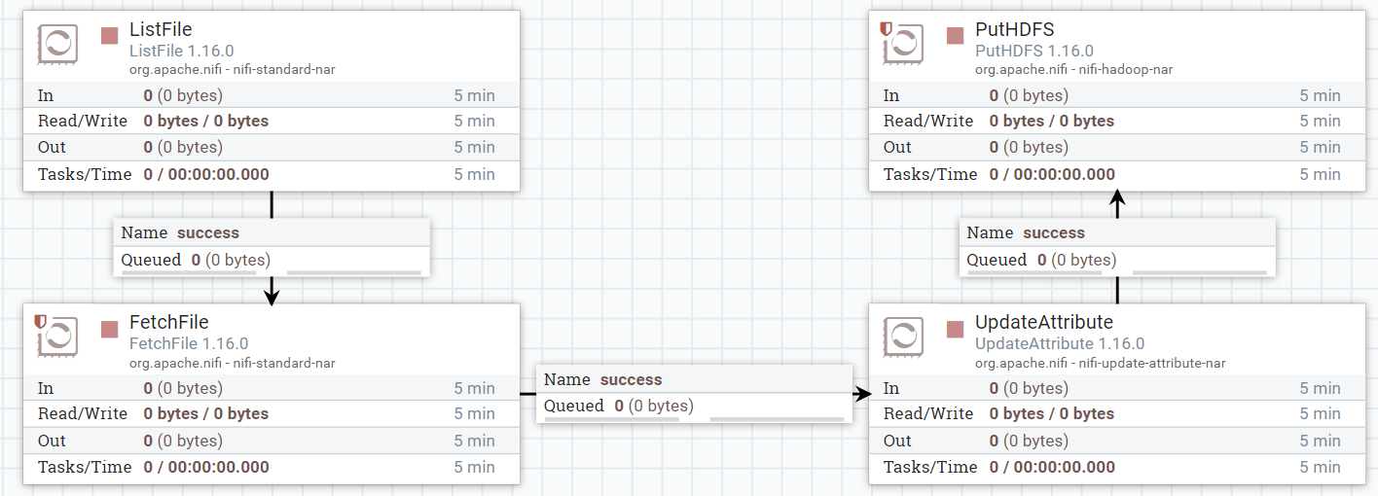
GREG
Data Ingestion
Data Ingestion - Nifi
1
2
3
4
Sources
Ingestion
Storage
Processing
Theme - files icon
* In this screenshot the Nifi flow has already been completed and interrupted, hence why the processors are empty
Notes:
The following screenshot represents the final flow in Nifi, after completion and interruption of the process

Slide 10
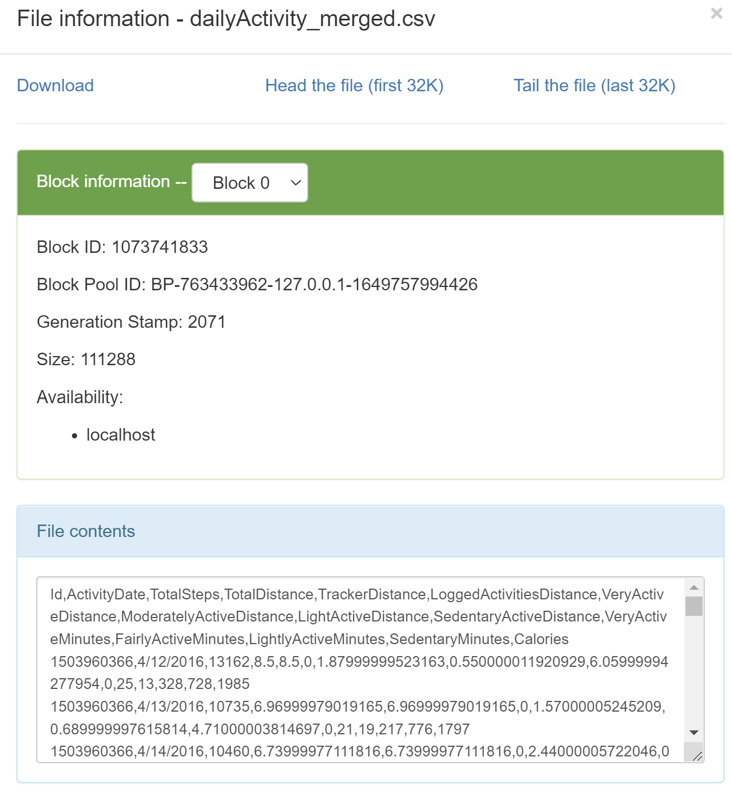
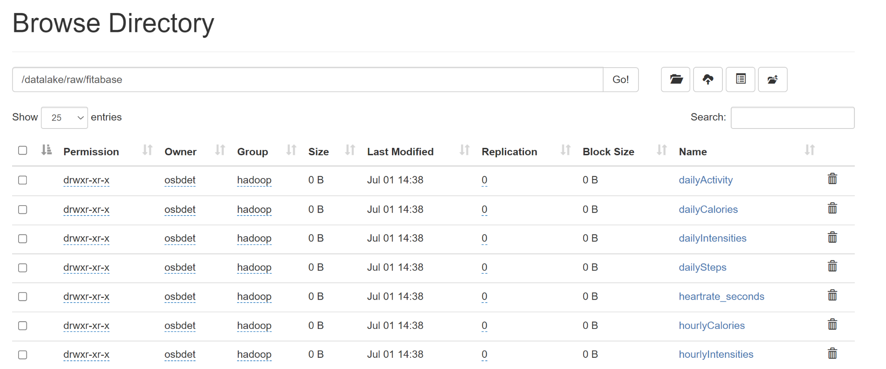
GREG
Data Ingestion
Data Storage - HDFS
1
2
3
4
Sources
Ingestion
Storage
Processing
Theme - files icon
Notes:
In order to confirm that our ingestion process ran correctly, we go to HDFS and check if our files have been correctly ingested.
It is the case here, so our data is ingested and ready to be processed. Off to you now Kaumu

Slide 11
KAUMU
Data Processing: Introduction
Understand customer behavior through analyzing their activity during the day
calorie spending
total number of steps
heart rate

Slide 12
KAUMU
Data Processing
Overview
01
Setup
02
Data Import
03
Data Overview & Cleaning
1
2
3
4
04
Data Analysis & Visualization
Sources
Ingestion
Storage
Processing
Theme - files icon

Slide 13
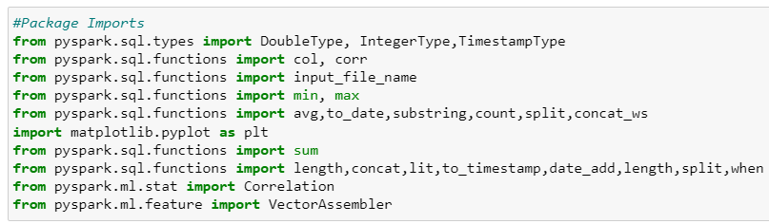
KAUMU
Data Processing: Setup
Pyspark Library
Functions for analysis & processing
Notes:
Spark unified processing framework

Slide 14
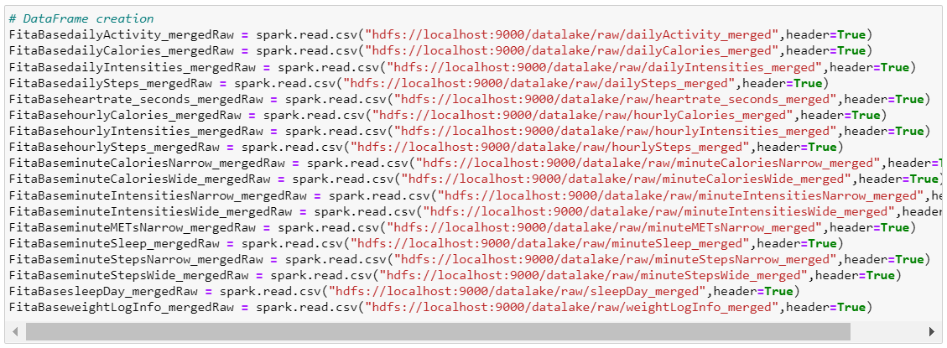
Data Processing: Data Import
Reading raw csv files as DataFrames
Notes:
Reading all the datasets from kaggle -> csv format

Slide 15
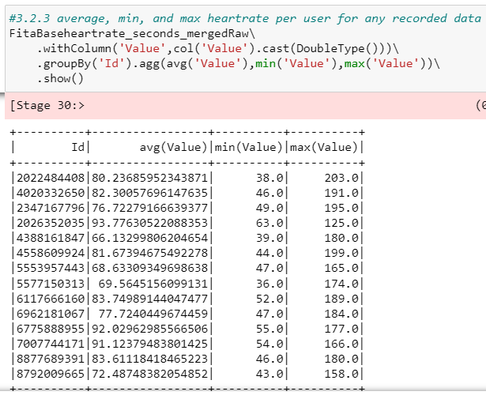
Data Processing: Data Overview & Cleaning
Time Range:
940 days
12th April 2016 - 9th June 2016
Number of Users: 33
Avg min/max heartrate

Slide 16
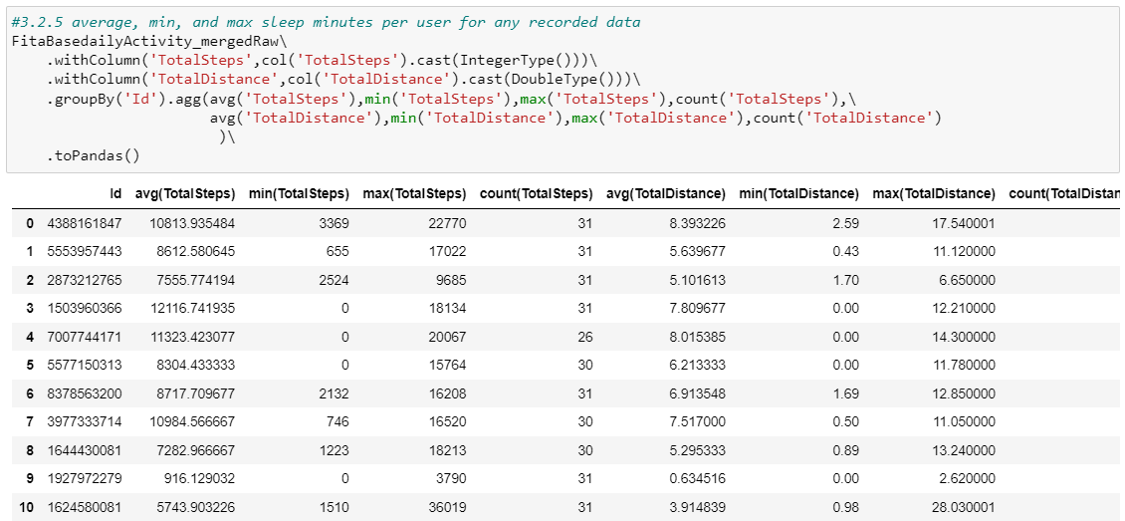
Data Processing: Data Overview & Cleaning

Slide 17
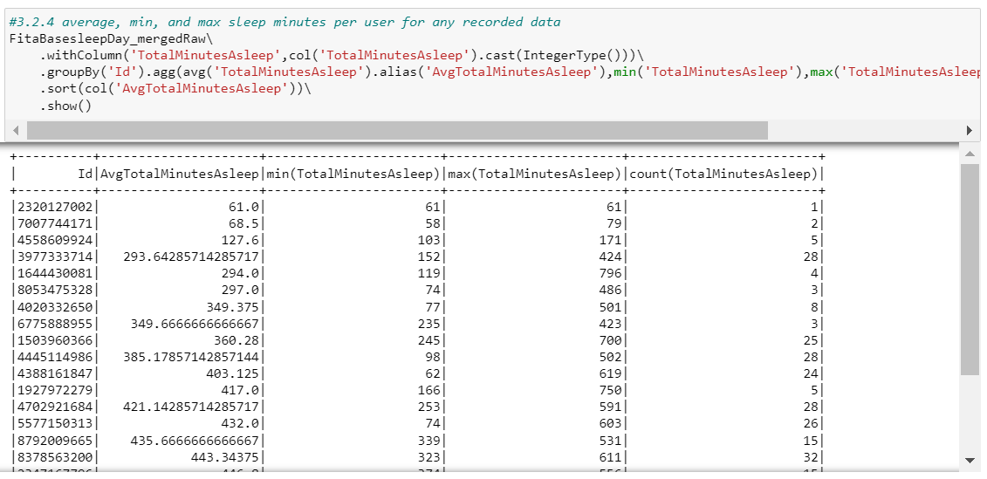
Data Processing: Data Overview & Cleaning
Users 2320127002, 7007744171, 4558609924 have anomolous data
-> remove in further analysis

Slide 18
Data Processing: Data Overview and Cleaning

Slide 19
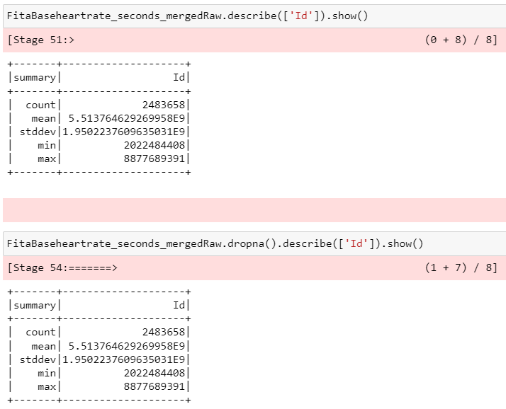
Data Processing: Data Overview and Cleaning

Slide 20
KAUMU
Data Summary
Conclusions from Data Overview:
Number of users and date range: Our data contains 33 uniqure person and tracked their activity records from 4/12/2016 to 5/9/2016, three of which gets removed because they have abnormal sleeping duration.
Data Type: Our data is pretty cleaned except the column type is string, this is due to the data ingestion, which consider all the columns as string when transferring the data
Data Column Observation:
Heart rate data has a legit upper, low, and average rate, so we would consider all data from this resource is valid
The following users has a weird sleep behavior and only a few records: ('2320127002','7007744171','4558609924'). As a result, we decided to remove these values from our future analysis. This ends up with 30 users instead
Notes:
Kaumu

Slide 21
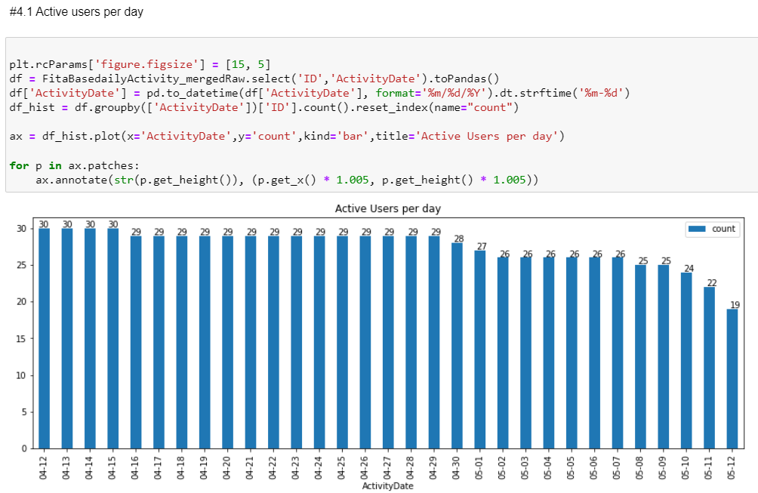
Zhizheng
Data Processing: Data Analysis and Visualization

Slide 22
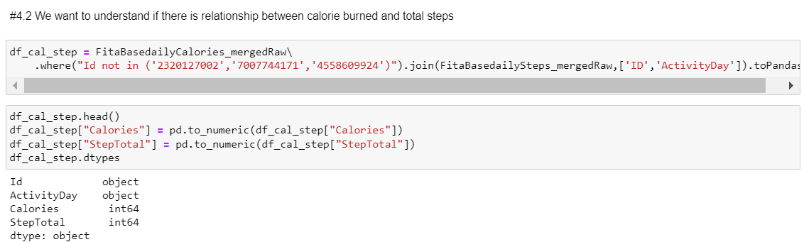
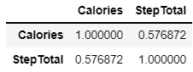
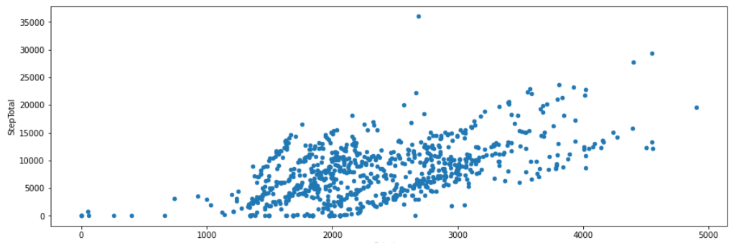
Data Processing: Data Analysis and Visualization

Slide 23
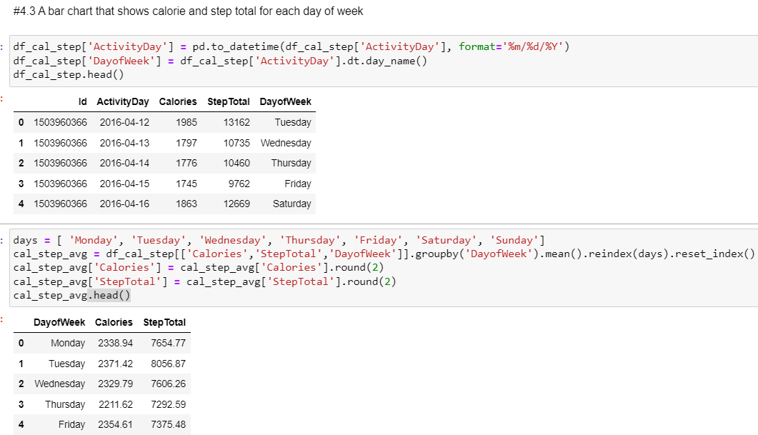
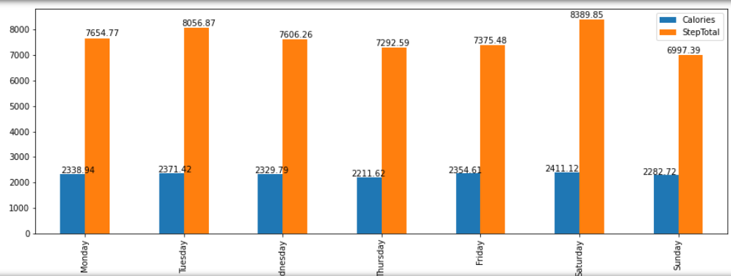
Data Processing: Data Analysis and Visualization

Slide 24
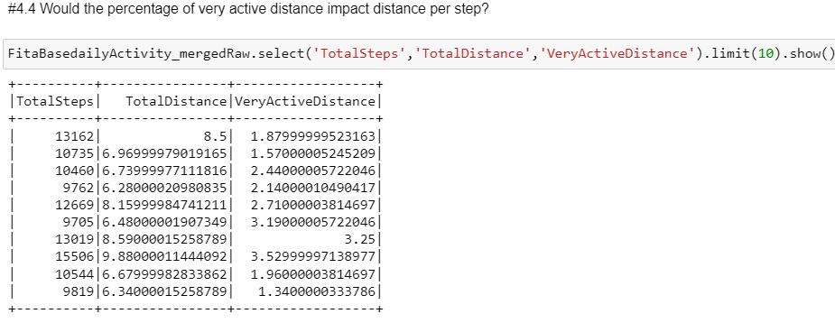
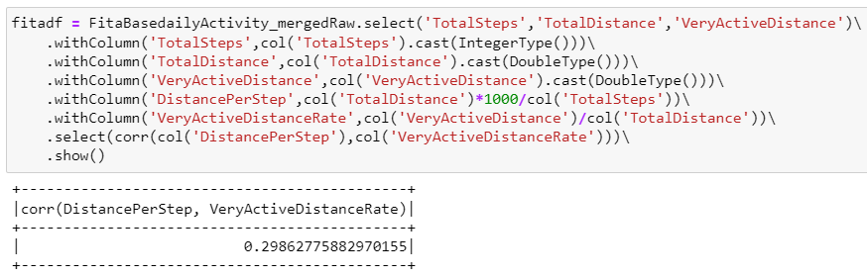
Data Processing: Data Analysis and Visualization

Slide 25
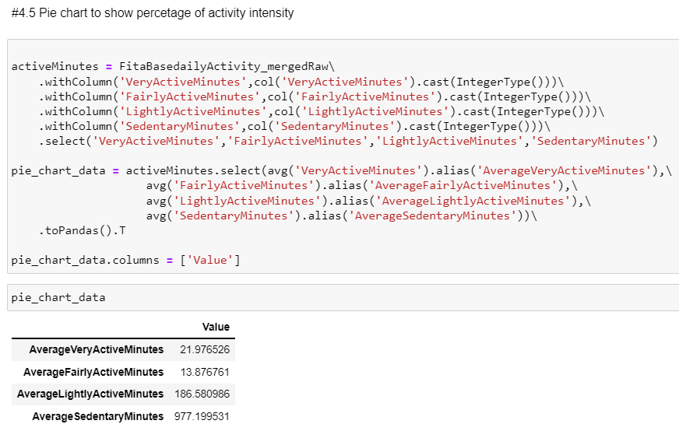
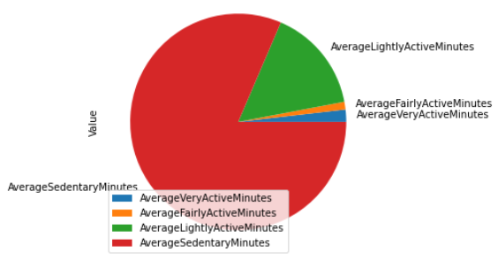
Data Processing: Data Analysis and Visualization

Slide 26
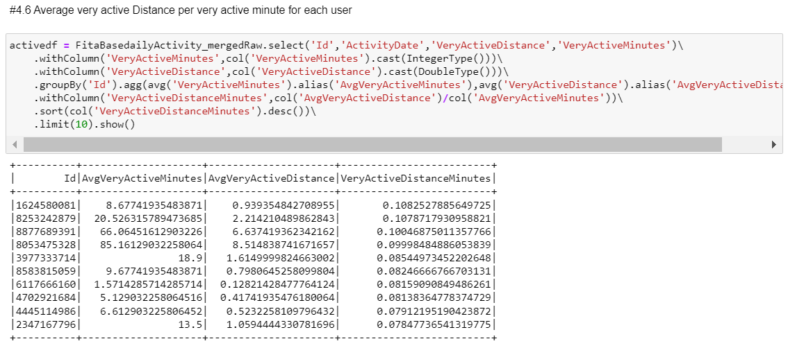
Data Processing: Data Analysis and Visualization

Slide 27
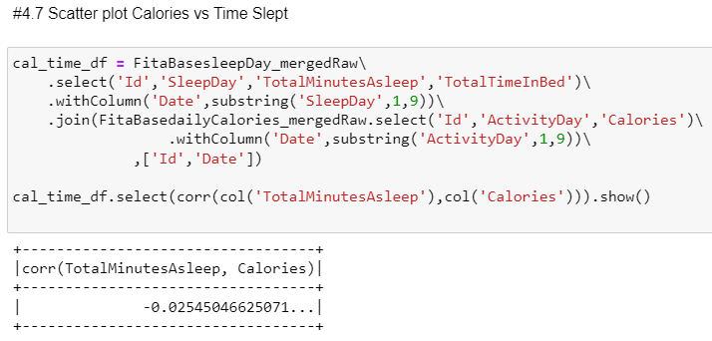
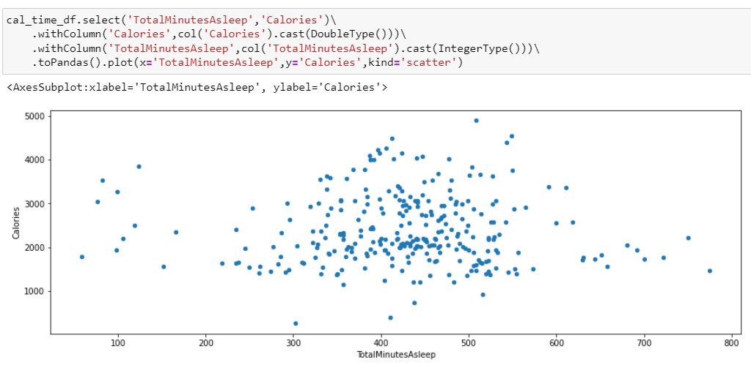
Data Processing: Data Analysis and Visualization

Slide 28
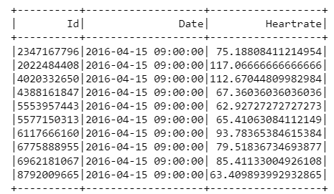
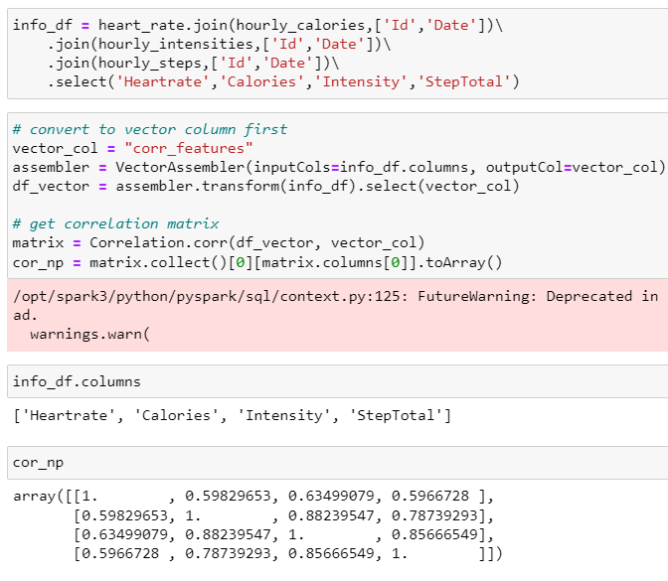
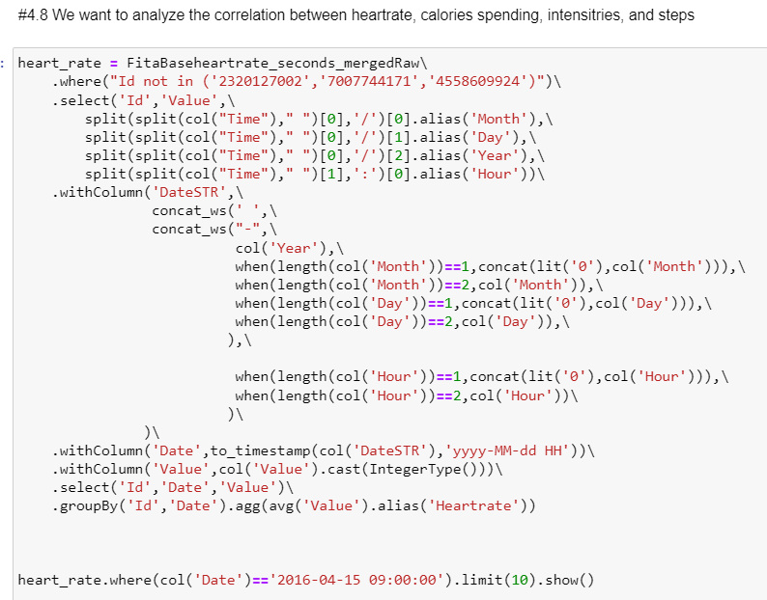
Data Processing: Data Analysis and Visualization

Slide 29
Zhizheng
Data Analysis Summarization
Conclusions from Data Analysis:
User participation rate:
We see active users has been going through a downward trend, the more the date, the less active users engaged in this app.
User behavior analysis:
Activity rate: The percentage of the type of active minutes shows that very active minutes only a small percentage out of all the tracked minutes, this makes sense as users can only be very active to a limited time
Day of week: From day of the week perspective, we see Sunday is the day that users burned the least calories and walked least amount of steps. This could because users are tend to do personal things at home instead of going out.
Feature correlation:
The correlation between percentage of very active distance for a users would impact the distance a user travel is 0.3, which indicates that there may be other factors that impacts distance a user travel while percentage of very active distance only make a marginal contribution
The correlation between Step Total and Calories burned is 0.577, this is an indication that there is some correlation between these two factors. This shows that we are somewhat able to conclude the more we walk, the more calories get burned
Very active distance under very active minutes shows that users would walk from 78 metres to 108 metres We see there is no correlation between total minutes sleep and calories burnt.
If we break Heart Rate, Calories, Intensity, and Step Total down to hourly perspective, we see factors have strong correlation between each other [0.59, 0.88]. In this case, these factors are relevant for further analysis.

Slide 30
Zhizheng
Recommendations
Recommendations:
User Retention: Users retention is always important for us to have a quality data analysis; hence, we need to work on how to engage our users to keep using our app.
Future Data Analysis strategy: If we look down the data to hourly data, not only see a stronger correlation between step total and calories compare to daily perspective, but all the factors is more accurate. Hence, we should consider our future data analysis would focus on hourly basis, or even minutes basis if possible
User Segmentation: Distance traveled by very active users is at around 100 meters. In this case, we might consider to have another level to differentiate people who are walking fast and who actually running/jogging

Slide 31
Data Visualizations
Chart Title Here
Chart Title Here

Slide 32
Data Visualizations
Chart Title Here
 | ROLE A | ROLE B | ROLE C | ROLE D | ROLE E
TASK 01
TASK 02
TASK 03
TASK 04
TASK 05
R
C
R
I
R
C
R
I
R
C
R
I
R
C
R
I
R
C
R
I

Slide 33
Conclusions

Slide 34
CHARTS WITH KEY POINTS
WRITE YOUR SUBTITLE HERE
BUSINESS KEY POINTS
CLIENT’S OPINIONS
Green marketing is a practice whereby companies seek to go above and beyond
Traditional marketing by promoting environmental core values in the hope that
Consumers will associate these values with their company or brand.
01
Green marketing is a practice whereby companies seek to go above and beyond.
02
Green marketing is a practice whereby companies seek to go above and beyond.

Slide 35
Data Ingestion
1
2
3
4
ListFile
FetchFile
Update
PutHDFS
Make a big impact with professional slides, charts, infographics and more.
Make a big impact with professional slides, charts, infographics and more.
Make a big impact with professional slides, charts, infographics and more.
Make a big impact with professional slides, charts, infographics and more.
Start
Goals

Slide 36
Overview
Goals
A
B
C
D
E
Identify
Improve
Innovation
Management
Success
Make a big impact with professional slides, charts, infographics and more.
Make a big impact with professional slides, charts, infographics and more.
Make a big impact with professional slides, charts, infographics and more.
Make a big impact with professional slides, charts, infographics and more.
Make a big impact with professional slides, charts, infographics and more.
Start

Slide 37
COLUMN CHART SLIDE
WRITE YOUR SUBTITLE HERE
NET GROWTH RATE (%)
Green marketing is a practice whereby companies seek to.
Green marketing is a practice whereby companies seek to.
01
04
Green marketing is a practice whereby companies seek to.
Green marketing is a practice whereby companies seek to.
02
05
Green marketing is a practice whereby companies seek to.
Green marketing is a practice whereby companies seek to.
03
06

Slide 38
Chart Template
Write here your awesome subtitle
Chart Title Here
Title 01
Title 02
Title 03
Title 04
Title 05
You can customize anything you see in this text-box.
You can customize anything you see in this text-box.
You can customize anything you see in this text-box.
You can customize anything you see in this text-box.
You can customize anything you see in this text-box.

Slide 39
Chart Template
Write here your awesome subtitle
Title 01
Title 02
Title 03
You can customize anything you see in this text-box.
You can customize anything you see in this text-box.
You can customize anything you see in this text-box.

Slide 40
Chart Template
Write here your awesome subtitle
Title 01
You can customize anything you see in this text-box, just write your information here.
Chart Title Here
Title 03
Title 02
You can customize anything you see in this text-box, just write your information here.
You can customize anything you see in this text-box, just write your information here.

Slide 41
Chart Template
Write here your awesome subtitle
Chart Title Here
Title 01
You can customize anything you see in this text-box.
Title 02
Title 03
You can customize anything you see in this text-box.
You can customize anything you see in this text-box.

Slide 42
Chart Template
Write here your awesome subtitle
2018
2019
2020
Title 01
Title 02
Title 03
You can customize anything you see in this text-box.
You can customize anything you see in this text-box.
You can customize anything you see in this text-box.

Slide 43
Chart Template
Write here your awesome subtitle
Chart Title Here
Title 01
You can customize anything you see in this text-box.
Title 02
You can customize anything you see in this text-box.
Title 03
You can customize anything you see in this text-box.
Title 04
You can customize anything you see in this text-box.

Slide 44
Chart Template
Write here your awesome subtitle
Chart Title Here
Title 01
You can customize anything you see in this text-box, just write your information here.
Title 02
You can customize anything you see in this text-box, just write your information here.
Title 03
You can customize anything you see in this text-box, just write your information here.

Slide 45
Chart Template
Write here your awesome subtitle
Title 01
Title 02
You can customize anything you see in this text-box.
You can customize anything you see in this text-box.
Title 03
Title 04
You can customize anything you see in this text-box.
You can customize anything you see in this text-box.
Title 05
Title 06
You can customize anything you see in this text-box.
You can customize anything you see in this text-box.

Slide 46
Chart Template
Write here your awesome subtitle
Chart Title Here
Title 02
Title 03
You can customize anything you see in this text-box.
You can customize anything you see in this text-box.
Title 01
Title 04
You can customize anything you see in this text-box.
You can customize anything you see in this text-box.

Slide 47
Chart Template
Write here your awesome subtitle
Chart Title Here
You can customize anything you see in this text-box, just write your information here.
Title 01
You can customize anything you see in this text-box.
Title 02
You can customize anything you see in this text-box.
Title 03
You can customize anything you see in this text-box.

Slide 48
Chart Template
Write here your awesome subtitle
Chart Title Here
Title 01
Title 02
You can customize anything you see in this text-box, just write your information here.
You can customize anything you see in this text-box, just write your information here.

Slide 49
Chart Template
Write here your awesome subtitle
Chart Title Here
Title 01
You can customize anything you see in this text-box.
Title 02
You can customize anything you see in this text-box.
Title 03
You can customize anything you see in this text-box.
Title 04
You can customize anything you see in this text-box.

Slide 50
Chart Template
Write here your awesome subtitle
Chart Title Here
You can customize anything you see in this text-box, just write your information here.
Title 01
You can customize anything you see in this text-box.
Title 02
You can customize anything you see in this text-box.
Title 03
You can customize anything you see in this text-box.

Slide 51
Chart Template
Write here your awesome subtitle
Chart Title Here
Title 01
Title 02
You can customize anything you see in this text-box.
You can customize anything you see in this text-box.
Title 03
Title 04
You can customize anything you see in this text-box.
You can customize anything you see in this text-box.

Slide 52
Chart Template
Write here your awesome subtitle
Chart Title Here
Title 01
Title 04
You can customize anything you see in.
You can customize anything you see in.
Title 02
Title 05
You can customize anything you see in.
You can customize anything you see in.
Title 03
Title 06
You can customize anything you see in.
You can customize anything you see in.

Slide 53
Chart Template
Write here your awesome subtitle
Title 01
Title 02
Title 03
Title 04
Title 05
You can customize anything you see in this text-box.
You can customize anything you see in this text-box.
You can customize anything you see in this text-box.
You can customize anything you see in this text-box.
You can customize anything you see in this text-box.

Slide 54
Chart Template
Write here your awesome subtitle
Title 01
Title 02
You can customize anything you see in this text-box, just write your information here.
You can customize anything you see in this text-box, just write your information here.
Title 03
Title 04
You can customize anything you see in this text-box, just write your information here.
You can customize anything you see in this text-box, just write your information here.

Slide 55
Chart Template
Write here your awesome subtitle
Chart Title Here
Title 01
Title 02
You can customize anything you see in this text-box, just write your information here.
You can customize anything you see in this text-box, just write your information here.

Slide 56
Chart Template
Write here your awesome subtitle
You can customize anything you see in this text-box, just write your information here.
Title 01
You can customize anything you see in this text-box.
Title 02
You can customize anything you see in this text-box.
Title 03
You can customize anything you see in this text-box.

Slide 57
Chart Template
Write here your awesome subtitle
Chart Title Here
Title 01
You can customize anything you see in this text-box.
Title 02
You can customize anything you see in this text-box.
Title 03
You can customize anything you see in this text-box.

Slide 58
Chart Template
Write here your awesome subtitle
Chart Title Here
Title 01
Title 02
Title 03
Title 04
You can customize anything you see in this text-box.
You can customize anything you see in this text-box.
You can customize anything you see in this text-box.
You can customize anything you see in this text-box.

Slide 59
BAR CHART SLIDE
WRITE YOUR SUBTITLE HERE
GROSS SALES ($M)

Slide 60
TABLE AND CHART SLIDE
WRITE YOUR SUBTITLE HERE
YOUR CHART TITLE
 | TITLE 01 | TITLE 02
Row One | 500 | 500
Row Two | 340 | 340
Row Three | 200 | 200
Row Four | 650 | 650
Row Five | 500 | 1300
Row Six | 850 | 850
Row Seven | 650 | 650
Total Row | 4500 | 4500
Green marketing is a practice whereby companies seek to go above and beyond.
Green marketing is a practice whereby companies seek to go above and beyond.
01
02

Slide 61
REGION REVENUE GROWTH CHART
WRITE YOUR SUBTITLE HERE
11%
43%
20%
31%
Your description
Your description
Your description
Your description
16%
Your description
REGION 1
REGION 2
17%
6%
Your description
Your description
7%
Your description
21%
14%
Your description
Your description
17%
Your description

Slide 62
BAR CHART SLIDE
WRITE YOUR SUBTITLE HERE
GROSS SALES PROJECTIONS (%)
100%
75%
50%
25%
0%
40%
45%
50%
55%
60%
65%
2019
2020
2021
2022
2023
2024

Slide 63
DATA DASHBOARD SLIDE
WRITE YOUR SUBTITLE HERE
YOUR TITLE 01
70%
50%
90%
75%
80%
Green marketing is a practice whereby companies seek to go above and beyond traditional marketing by promoting.
YOUR TITLE 02
TITLE 01
TITLE 02
TITLE 03
TITLE 04
60%
Green marketing is a practice whereby companies seek to go above and beyond traditional marketing by promoting.

Slide 64
BAR CHART SLIDE
WRITE YOUR SUBTITLE HERE
CLIENT’S OPINIONS
Green marketing is a practice whereby companies seek to go above and beyond
Traditional marketing by promoting environmental core values in the hope that
Consumers will associate these values with their company or brand.
Engaging in these sustainable activities can lead to creating a new product line that caters to a new target market.
This is also sometimes known as sustainable marketing, environmental marketing or ecological marketing.

Slide 65
DATA CHART SLIDE
WRITE YOUR SUBTITLE HERE
YOUR TITLE 01
Green marketing is a practice whereby companies seek to go above and beyond.
YOUR TITLE 02
Green marketing is a practice whereby companies seek to go above and beyond.
YOUR TITLE 03
Green marketing is a practice whereby companies seek to go above and beyond.

Slide 66
DATA BAR CHART SLIDE
WRITE YOUR SUBTITLE HERE
Green marketing is a practice whereby companies seek to go above and beyond traditional marketing by promoting environmental core values in the hope that consumers will associate these values with their company or brand. Engaging in these sustainable activities can lead to creating a new product line that caters.
YOUR TITLE 01
YOUR TITLE 02
YOUR TITLE 03
YOUR TITLE 04
Green marketing is a practice whereby companies seek to go above and beyond traditional.
Green marketing is a practice whereby companies seek to go above and beyond traditional.
Green marketing is a practice whereby companies seek to go above and beyond traditional.
Green marketing is a practice whereby companies seek to go above and beyond traditional.

Slide 67
DATA BAR CHART SLIDE
WRITE YOUR SUBTITLE HERE
Green marketing is a practice whereby companies seek to go above and beyond traditional marketing by promoting environmental core values in the hope that consumers will associate these values with their company or brand. Engaging in these sustainable activities can lead to creating a new product line that caters.
YOUR TITLE 01
YOUR TITLE 02
Green marketing is a practice whereby companies seek to go.
Green marketing is a practice whereby companies seek to go.
YOUR TITLE 03
YOUR TITLE 04
Green marketing is a practice whereby companies seek to go.
Green marketing is a practice whereby companies seek to go.

Slide 68
DATA BAR CHART SLIDE
WRITE YOUR SUBTITLE HERE
Green marketing is a practice whereby companies seek to go above and beyond traditional marketing by promoting environmental core values in the hope that consumers will associate these values with their company or brand. Engaging in these sustainable activities can lead to creating a new product line that caters.
YOUR TITLE 01
YOUR TITLE 02
Green marketing is a practice whereby companies seek to go.
Green marketing is a practice whereby companies seek to go.
YOUR TITLE 03
YOUR TITLE 04
Green marketing is a practice whereby companies seek to go.
Green marketing is a practice whereby companies seek to go.

Slide 69
DATA BAR CHART SLIDE
WRITE YOUR SUBTITLE HERE
Green marketing is a practice whereby companies seek to go above and beyond traditional marketing by promoting environmental core values in the hope that consumers will associate these values with their company or brand. Engaging in these sustainable activities can lead to creating a new product line that caters.
YOUR TITLE 01
YOUR TITLE 02
YOUR TITLE 03
YOUR TITLE 04
Green marketing is a practice whereby companies seek to go above and beyond traditional.
Green marketing is a practice whereby companies seek to go above and beyond traditional.
Green marketing is a practice whereby companies seek to go above and beyond traditional.
Green marketing is a practice whereby companies seek to go above and beyond traditional.

Slide 70
DATA BAR CHART SLIDE
WRITE YOUR SUBTITLE HERE
Green marketing is a practice whereby companies seek to go above and beyond traditional marketing by promoting environmental core values in the hope that consumers will associate these values with their company or brand. Engaging in these sustainable activities can lead to creating a new product line that caters.
01
Green marketing is a practice whereby companies seek to go.
02
Green marketing is a practice whereby companies seek to go.
03
Green marketing is a practice whereby companies seek to go.
04
Green marketing is a practice whereby companies seek to go.

Slide 71
DATA BAR CHART SLIDE
WRITE YOUR SUBTITLE HERE
Green marketing is a practice whereby companies seek to go above and beyond traditional marketing by promoting environmental core values in the hope that consumers will associate these values with their company or brand. Engaging in these sustainable activities can lead to creating a new product line that caters.
Green marketing is a practice whereby companies seek to go.
01
Green marketing is a practice whereby companies seek to go.
02
Green marketing is a practice whereby companies seek to go.
03
Green marketing is a practice whereby companies seek to go.
04

